Slide 1
Smart Contract Coordinated Privacy Preserving Crowd-Sensing Campaigns
Davide Leone

Slide 2
Introduction
Crowd-sensing = participatory data collection using mobile devices.
Challenges:
Data privacy and identity exposure.
Data quality and trust.
Cheating and system abuse.
Goal: Create a decentralized, privacy-preserving, and incentive-compatible system using smart contracts.

Slide 3
Core Problems
Privacy:
Even anonymized data can be re-identified in sparsely populated areas.
Data volume can correlate with user behavior.
Trust → use of centralized systems, which are prone to:
Single point of failure
Data breaches

Slide 4
Design Goals
Key requirements for privacy-preserving crowd-sensing:
Anonymization
Anonymization set (minimum participant threshold)
Uniform data chunking
Decentralized coordination (no single point of failure)
Furthermore, to ensure the success of the campaign, incentives are critical.

Slide 5
Proposed Solution: Actors
ACTOR | ROLE
User | Provides encrypted data in return for rewards.
Smart Contract (SC) | Coordinates actions, stores metadata, handles incentives.
Verifier | Validates submitted data and is rewarded for accurate verification.
Decentralized File Storage | Host encrypted data.

Slide 6
Proposed Solution: Protocol Overview
The Smart Contract (SC) is created, and the campaign is opened.
User collects data, pays the fee, and requests encryption key.
User encrypts data and uploads them to DFS, as separate data chunks.
User communicates to the SC the position of the data in the DFS.
SC assigns a trustworthy verifier.
Verifier downloads, decrypts, and verifies the data. Then, is rewarded.
If data is valid, the user is rewarded and is added to verified list.
Once threshold is met, data becomes accessible.

Slide 7

SMART CONTRACT IMPLEMENTATION

Slide 8
Structs
struct UserData
dataLocation | Indicates where the data is stored.
isVerified | Indicates whether the data has been verified.
isRewarded | Indicates if the user has received a reward.
encryptionKey | Encryption key for user data.
chunkSize | Size of encrypted data chunks.
struct Campaign
minParticipants | Threshold to trigger reward distribution.
currentParticipants | Current number of verified users.
rewardAmount | How much each verified participant receives.
isClosed | Marks whether the campaign is concluded.

Slide 9
State Variables and Modifiers
VARIABLES
owner | Address of the entity or person interested in the data gathering.
fee | Fee to discourage cheating and prevent DoS attacks.
userData | Mapping from user address to their data.
assignedVerifiers | Mapping from assigned verifier to each user.
verifiers | List of addresses of allowed verifiers.
verifiedUsers | List of addresses of validated contributors.
MODIFIERS
onlyOwner() | Restrict function access to only the contract owner.

Slide 10
Functions (1)
OWNER
addVerifier() | Allows to add verifiers.
removeVerifier() | Allows to remove verifiers.
setFee() | Allows to change the submission fee.
distributeRewards() | Distributes rewards to verified users once the minimum threshold is met.
withdraw() | Allows to withdraw contract balance once the campaign is closed.
restartCampaign() | Restart a new campaign after closing the previous one.

Slide 11
Functions (2)
USER
requestEncryptionKey() | Allows to request an encryption key before submitting data.
submitData() | Allows to submit data by paying a fee.
CAMPAIGN
isVerifier() | Checks if an address is a verifier.
selectVerifier() | Randomly selects a verifier for a user.
VERIFIERS
requestDataVerification() | Allows to request data for verification.
verifyData() | Allows verifiers to validate submitted data.

Slide 12

Events
EncryptionKeyGenerated |  | VerifierAdded
EncryptionKeyShared |  | VerifierRemoved
DataSubmitted |  | VerifierRewarded
DataVerified |  | FeeUpdated
 |  | CampaignClosed
RewardDistributed

Slide 13
Security and Quality Mechanisms
onlyOwner Modifier
One-Time Participation
Fee on Data Submission
Verifier Assignment
Verification Process
Reward Distribution Conditions

Slide 14
Privacy Preserving Features
Encrypted Data Storage
Per-User Encryption Keys
Encryption Key Sharing on Reward
Uniform Chunk Sizes

Slide 15

TESTING

Slide 16
Testing Strategy
Functional Tests: Verify main workflows (key generation, data submission, verification, rewards).
Security Tests: Ensure only authorized users (e.g., owner/verifier) can perform sensitive operations.
Gas Analysis: Measure and report gas usage across scale.
Objective: Validate correctness, security, and performance.

Slide 17
Key Functional Test Scenarios
Add/remove verifiers
User requests encryption key
Submit data with fee
Assign verifier
Verify data + Update campaign state
Distribute rewards
Restart campaign

Slide 18
Security & Access Control Tests
Unauthorized actions prevented:
Adding/removing verifiers by non-owner
Setting fees by non-owner
Submitting data with insufficient fee
Verifying data by unauthorized address
Funds withdrawal by non-owner

Slide 19
Empirical Gas Usage
Purpose: Measure scalability and performance across varying user counts.
Test categories:
Small Scale: 1–9 users
Medium Scale: 10–90 users
Large Scale: 100–500 users
Metrics collected on:
Data Submission
Data Verification
Reward Distribution
Total Gas Used

Slide 20
Total Gas Usage Trends
# Users | Data Submission | Data Verification | Reward Distribution | Total Gas Used
1 | 84,366 | 126,707 | 78,498 | 289,571
10 | 843,660 | 959,258 | 286,002 | 2,088,920
50 | 4,218,780 | 4,659,502 | 1,208,242 | 10,086,524
100 | 8,437,680 | 9,284,744 | 2,361,042 | 20,083,466
200 | 16,876,680 | 18,535,336 | 4,666,642 | 40,078,658
300 | 25,315,680 | 27,785,952 | 6,972,242 | 60,073,874
400 | 33,754,680 | 37.036,544 | 9,277,842 | 80,069,066
500 | 42,193,680 | 46,287,160 | 11,583,442 | 100,064,282

Slide 21
Average Gas Usage Trends
# Users | Data Submission | Data Verification | Reward Distribution | Total Gas Used
1 | 84,366 | 126,707 | 78,498 | 289,571
10 | 84,366 | 95,926 | 28,600 | 208,892
50 | 84,376 | 93,190 | 24,165 | 201,730
100 | 84,377 | 92,847 | 23,610 | 200,835
200 | 84,383 | 92,676 | 23,333 | 200,393
300 | 84,386 | 92,620 | 23,240 | 200,246
400 | 84,387 | 92,591 | 23,194 | 200,172
500 | 84,387 | 92,574 | 23,166 | 200,128

Slide 22
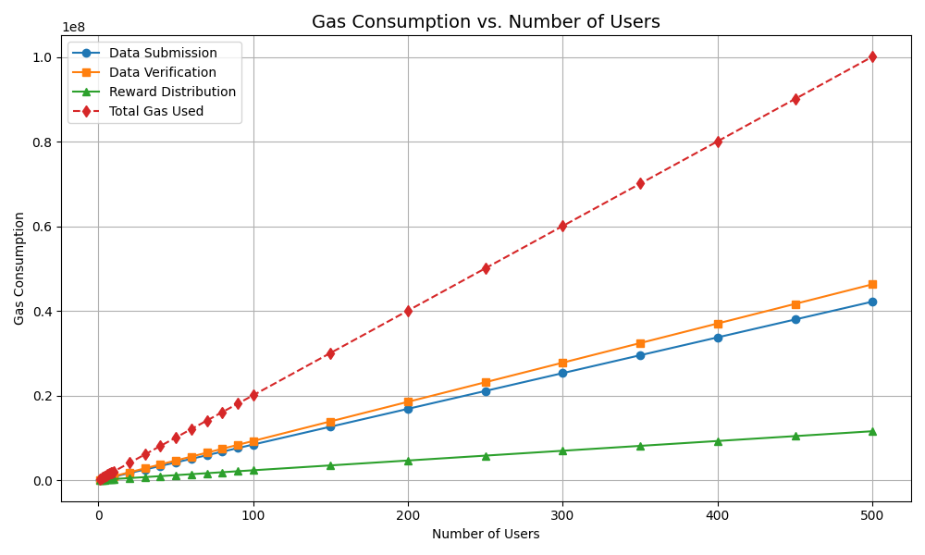

Slide 23
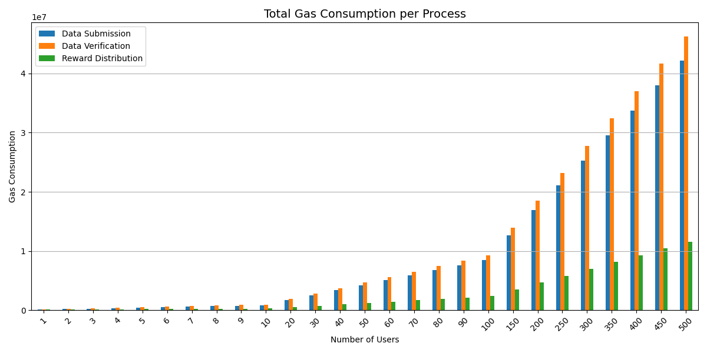

Slide 24
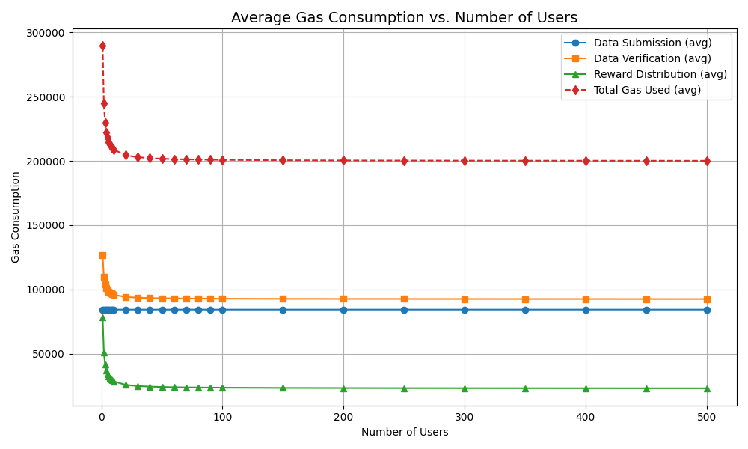

Slide 25
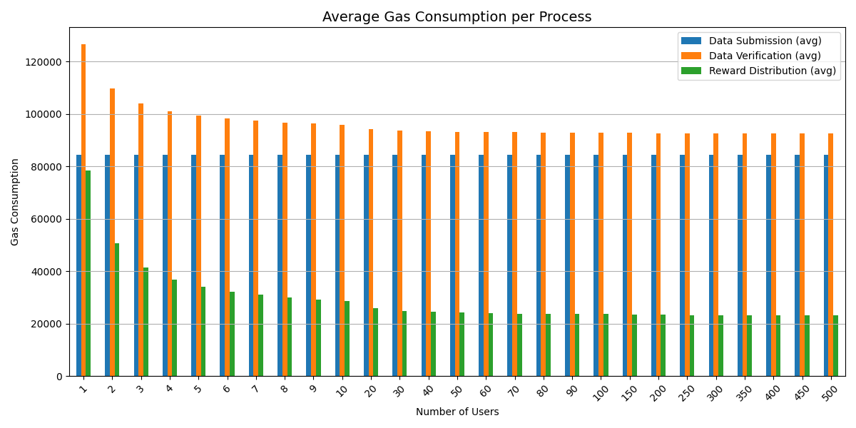

Slide 26
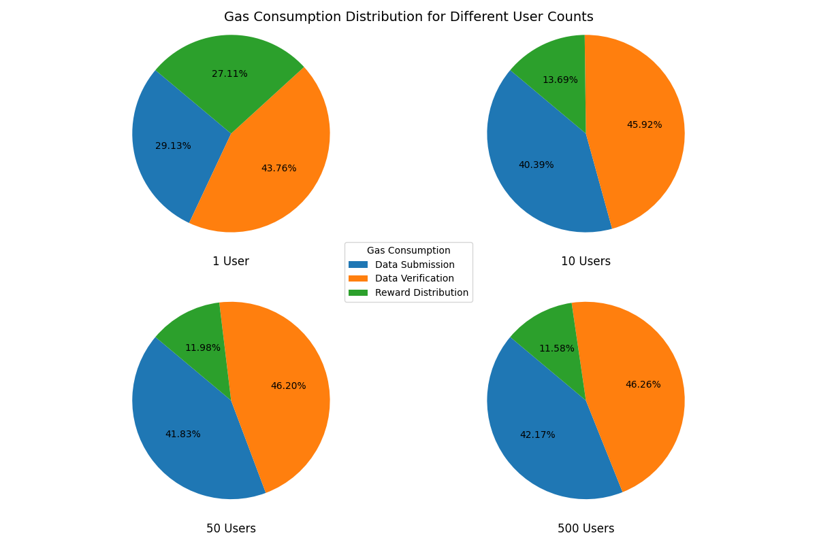

Slide 27
Conclusions
Decentralization ensures trust without a central authority
Strong privacy mechanisms protect user identity
Smart contracts enforce fairness and accountability
Incentives align user and verifier interests
Functional, security, and gas tests confirm system reliability
Gas usage scales efficiently with users

Slide 28
Thank you for your attention!
Davide Leone

